Slide 1
Introduction to scRNA-seq Technology
CDS-SR scRNA-seq Workshop 2022
(Part 1)
Slide 1

Slide 2

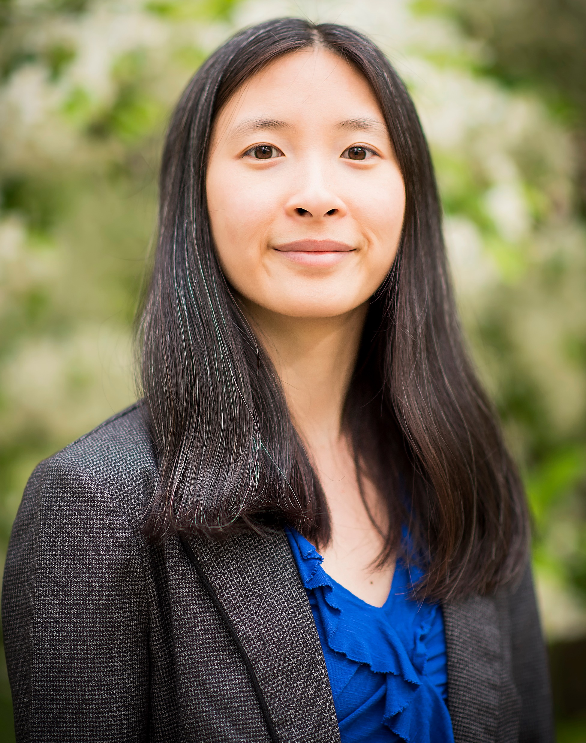
Bioinformatician at the Cancer Data Science Shared Resource (CDS-SR)
CDS-SR provides support and collaboration to Rogel Cancer Center investigators in biostatistical and bioinformatics analyses
Analyze many high-throughput data
scRNA-seq
CyTOF
16S microbiome
Stephanie The, MS
Bioinformatician/Computational Biologist Associate, Department of Biostatistics
Interested in our services? Go here:
https://sph.umich.edu/cds/index.html
Slide 2
Notes:
Arvind will introduce me

Slide 3
Before we start…
This is an evolving field, and tools and algorithms can change all the time
Some of the things I say in this workshop might not hold in future years
scRNA-seq analysis can be complicated!
In this workshop:
Broadly introduce common processing steps
Give advice on analysis
Show common situations when analyzing
Slide 3

Slide 4
Workshop Materials
You can find the lecture slides, code, and other documents on the workshop’s Github page
https://github.com/tstephie/UMICH-CDS-SR-scRNA-seq-Workshop-2022
To find the lecture slides for Section 1, go here:
https://github.com/tstephie/UMICH-CDS-SR-scRNA-seq-Workshop-2022/tree/main/section_1/powerpoint_lectures
To find the code used to create some of the figures for Section 1 slides, go here:
https://github.com/tstephie/UMICH-CDS-SR-scRNA-seq-Workshop-2022/tree/main/section_1/code
Slide 4

Slide 5
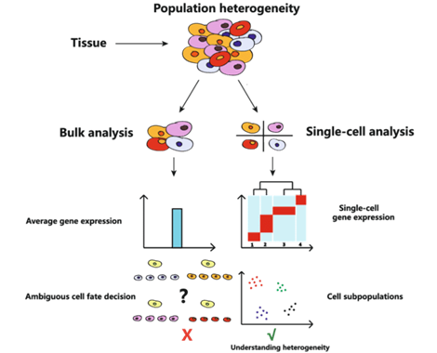
What is scRNA-seq?
Population heterogeneity
Tissue
scRNA-seq = single-cell RNA sequencing
Exploratory analysis of the transcriptome at a single cell resolution
Similar to bulk RNA-seq but not looking just at the average expression of genes
Bulk analysis
Single-cell analysis
Average gene expression
Single-cell gene expression
Ambiguous cell fate decisions
Cell subpopulations
Understanding
heterogeneity
https://www.lcsciences.com/documents/sample_data/single_cell_rna_seq/scRNA_seq_html_report_DEMO.html
Slide 5
Notes:
Difference b/w bulk and sc:
take tissue
bulk -> average gene expression -> ambiguous cell types? (unless isolate one cell type and sequence at a time)
sc -> gene expression for each cell (can average too) -> cell types

Slide 6

WARNING!!
scRNA-seq is for exploratory analysis
Initially investigate data to discover patterns, anomalies, test hypotheses, and check assumptions
Generate new hypotheses
Can’t make conclusions
Will have to validate with separate experiments
Slide 6

Slide 7
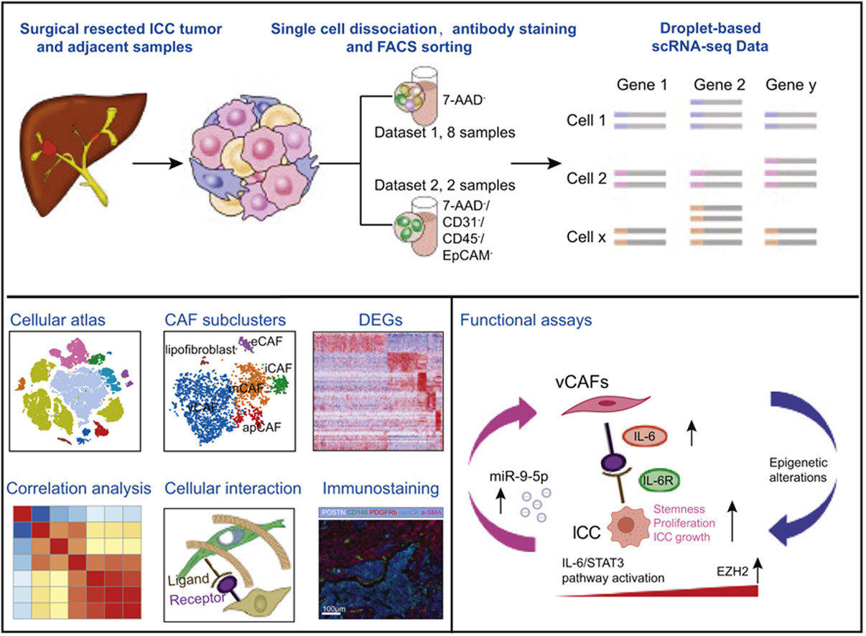
What can you do with scRNA-seq?
Observe cell heterogeneity within a population (ex: tumor microenvironment)
Study complexity of biological systems
Study how cells interact in systems
Fields of study that use scRNA-seq
Immunology
Neurology
Stem cell biology
Oncology
Functional genomics
And more!
https://www.journal-of-hepatology.eu/article/S0168-8278(20)30360-3/fulltext
Slide 7

Slide 8
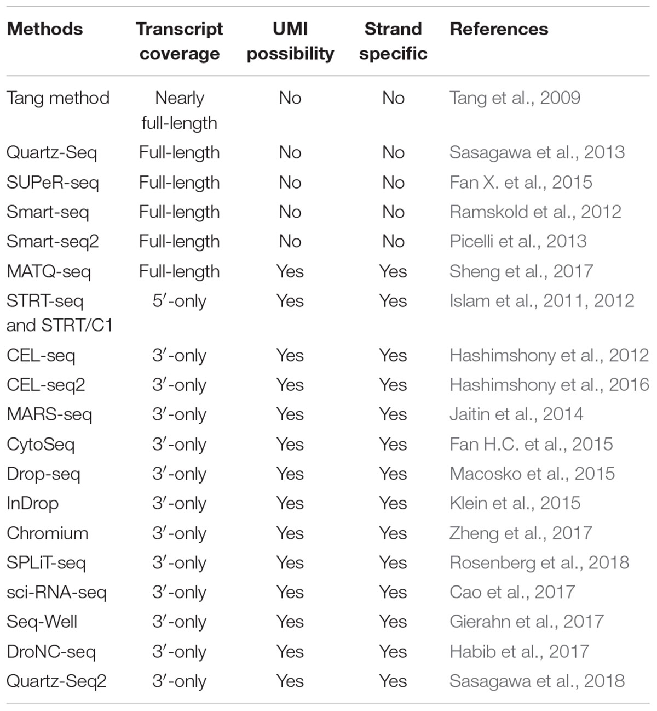
scRNA-seq Technology
Many scRNA-seq technologies
10X Genomics Chromium is used at Advanced Genomics Core (AGC) at UMICH
https://www.frontiersin.org/articles/10.3389/fgene.2019.00317/full#:~:text=Single%2Dcell%20RNA%20sequencing%20
Slide 8

Slide 9
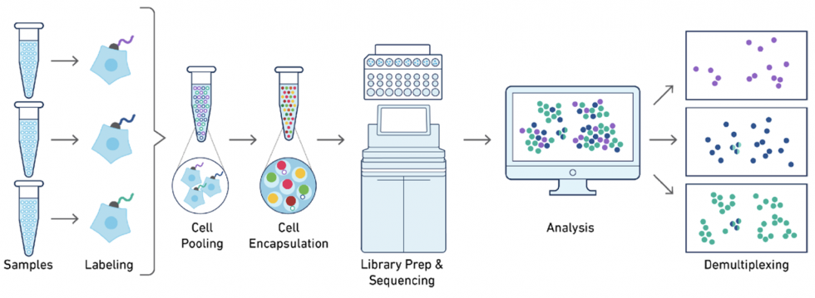
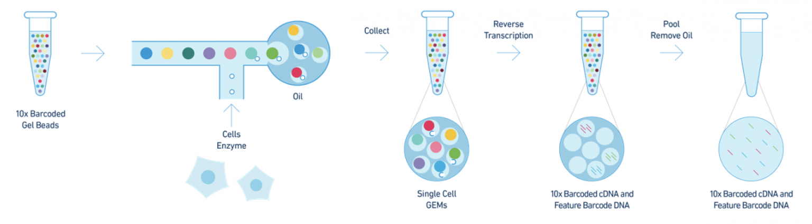
10X Genomics Chromium Controller Chromium Technology
Performs rapid droplet-based encapsulation of single cells
Uses gel bead in emulsion (GEM) approach
Slide 9
https://genomemedicine.biomedcentral.com/articles/10.1186/s13073-017-0467-4
https://brcf.medicine.umich.edu/cores/advanced-genomics/technologies/single-cell/10x-genomics/

Slide 10
10X Genomics Chromium Controller Chromium Technology
Step 1
Step 1:
Cells in each sample are labeled with a unique sample tag or sequence
Allows for multiplexing (aka pool samples)
Saves money and reduce the chance of potential batch effects
Slide 10
https://genomemedicine.biomedcentral.com/articles/10.1186/s13073-017-0467-4

Slide 11
10X Genomics Chromium Controller Chromium Technology
Step 2
Step 2:
Gel beads are barcoded with unique barcodes
Unique barcodes help to separately index each cell
Slide 11
https://genomemedicine.biomedcentral.com/articles/10.1186/s13073-017-0467-4
https://brcf.medicine.umich.edu/cores/advanced-genomics/technologies/single-cell/10x-genomics/

Slide 12
10X Genomics Chromium Controller Chromium Technology
Step 3
Step 3:
Beads, cells, enzymes, and partitioning oil are mixed together
Beads and cells are separated into bead-cell pairs by partitioning oil to create GEMs
Theoretically should be 1:1 for bead:cell
Slide 12
https://genomemedicine.biomedcentral.com/articles/10.1186/s13073-017-0467-4
https://brcf.medicine.umich.edu/cores/advanced-genomics/technologies/single-cell/10x-genomics/

Slide 13
10X Genomics Chromium Controller Chromium Technology
Step 4
Step 4:
GEMs undergo reverse transcription (RT) and generate cDNA library
cDNA from a cell will share common barcode
Slide 13
https://genomemedicine.biomedcentral.com/articles/10.1186/s13073-017-0467-4
https://brcf.medicine.umich.edu/cores/advanced-genomics/technologies/single-cell/10x-genomics/

Slide 14
10X Genomics Chromium Controller Chromium Technology
Step 5
Step 5:
Sequence cDNA
Output = raw base call (BCL) files
Slide 14
https://genomemedicine.biomedcentral.com/articles/10.1186/s13073-017-0467-4
https://brcf.medicine.umich.edu/cores/advanced-genomics/technologies/single-cell/10x-genomics/

Slide 15
10X Genomics Chromium Controller Chromium Technology
Step 6
Step 6:
Convert BCL files -> FASTQ files -> counts (UMIs) and do further analysis
Will demultiplex if samples were pooled together
Slide 15
https://genomemedicine.biomedcentral.com/articles/10.1186/s13073-017-0467-4
https://brcf.medicine.umich.edu/cores/advanced-genomics/technologies/single-cell/10x-genomics/

Slide 16
Advantages in scRNA-seq
Single cell resolution allows us to study gene expression patterns of populations
Find and study rare cell populations
Identify gene regulatory networks, developmental trajectories, etc.
Slide 16

Slide 17
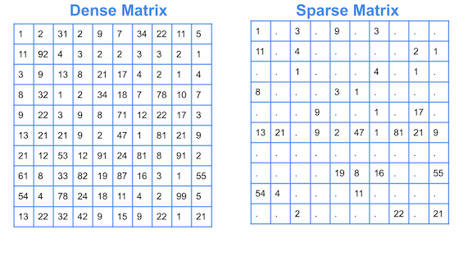
Disadvantages in scRNA-seq
“Noisy” data
Working with sparse data
Lots of the counts will be zero
Zeros can be due to biological or technical effects
https://cmdlinetips.com/2018/03/sparse-matrices-in-python-with-scipy/
Slide 17

Slide 18
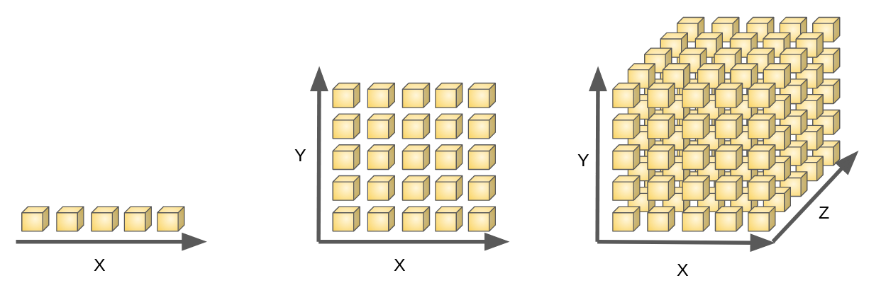
Disadvantages in scRNA-seq
Dimensionality
Dimensionality = how many features/variables are in the data
Features/variables = age, sex, color, weight, height, etc.
In scRNA-seq, features are genes
scRNA-seq suffers from the curse of dimensionality
# of features >> # cells
Looking over 10,000 genes (yikes!)
We have ways of dealing with this analytically
https://www.i2tutorials.com/what-do-you-mean-by-curse-of-dimensionality-what-are-the-different-ways-to-deal-with-it/
Slide 18

Slide 19
Disadvantages in scRNA-seq
CPU and Memory Usage
scRNA-seq can require a lot of processing power and memory storage
Recommended to find a place to store data (even before analyzing)
Ex: Turbo, Data Den, Google Drive, DropBox, external drive
Google Drive, DropBox, and external drive are less recommended due to accessibility and HIPAA compliance (if have sensitive data)
If don’t have good CPU or memory usage on own computer, then use high-performance computing (HPC) clusters
My local computer has ~16GB RAM
On campus resources = GreatLakes, Armis2, Biostatistics cluster, etc.
Slide 19

Slide 20
Disadvantages in scRNA-seq
CPU and Memory Usage
University of Michigan Research Computing Package (UMRCP)
Available to all researchers (PIs, PostDocs, PHD) on campus
Get 80,000 CPU hours of HPC
10 TB Turbo storage
100 TB of archive storage
Link here: https://arc.umich.edu/umrcp/
Slide 20

Slide 21
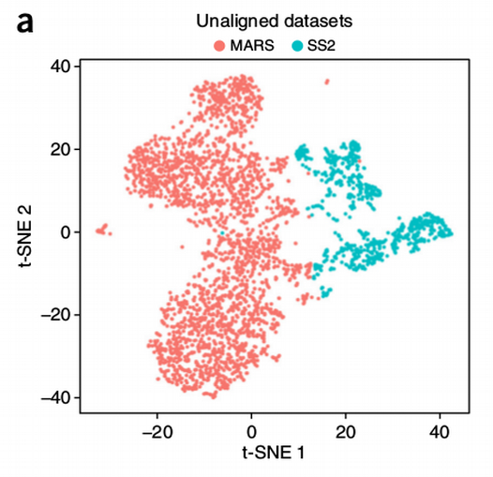
Disadvantages in scRNA-seq
Batch effect
Batch effect = technical, non-biological factors can create variation in data
Depends on the setup of the experiment
Ex: sample collection (how and when), protocols, sequencing technologies (type of machine and when), etc.
Ways to reduce batch effect:
Use same protocols when prepping samples
Run on same type of sequencing machine
Multiplex (prevents differences between runs)
Have ways to reduce batch effect analytically, but recommended to plan experiments with this in mind
https://towardsdatascience.com/how-to-batch-correct-single-cell-7bad210c7ae1
Slide 21

Slide 22
I don’t know where to start. Where should I get help?
Experimental setup:
Advanced Genomics Core (AGC): https://brcf.medicine.umich.edu/cores/advanced-genomics/
Single Cell Spatial Analysis Core: https://www.rogelcancercenter.org/research/shared-resources-and-cores/single-cell-analysis-core-overview
Analysis
Cancer Data Science Shared Resource (CDS-SR): https://sph.umich.edu/cds/
Bioinformatics Core: https://brcf.medicine.umich.edu/cores/bioinformatics-core/
Ask co-workers/collaborators that have worked with scRNA-seq data!
Slide 22

